Slide 1
Web Design & Development Y2/Sem 1
Week 2. Html+css

Slide 2
Overview
Basic Page Structure
Viewport
HTML Structural elements
CSS

Slide 3
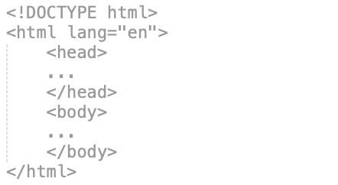
Basic Page Structure
HTML5 doctype is html
Every page will have <head> and <body>
lang attribute is optional but recommended
<head> contains information about the page (called metadata), external files
<body> contains all visible page content

Slide 4
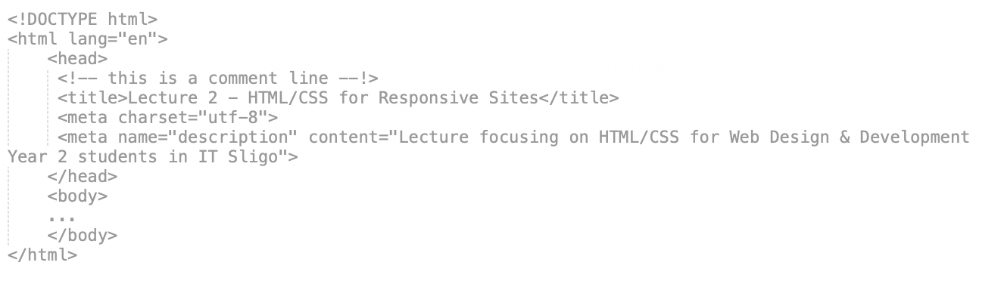
Basic Page Structure
<title> - seen at top of browser window, open tab, bookmarks, link text in SERPS – 64 char max recommended
Page can have one or more <meta> elements
charset attribute – character encoding for international languages
description attribute – a summarisation of the content of the page (max 160 chars) – link description in SERPS

Slide 5
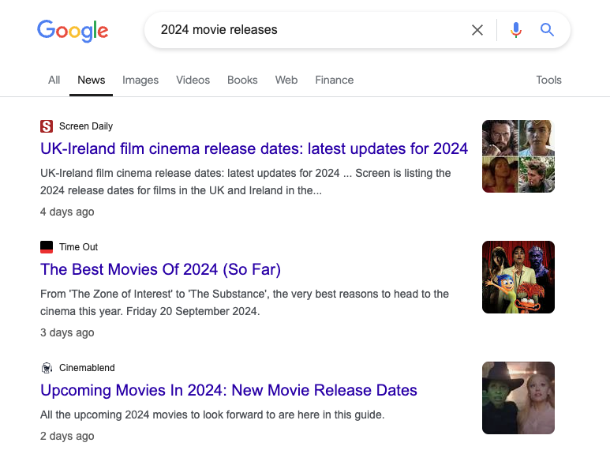
SERPS Page example
Page title with site name
Page title divided from site name with dash or pipe or colon
Date page updated/reindexed
Short sentence for meta description otherwise page content used

Slide 6
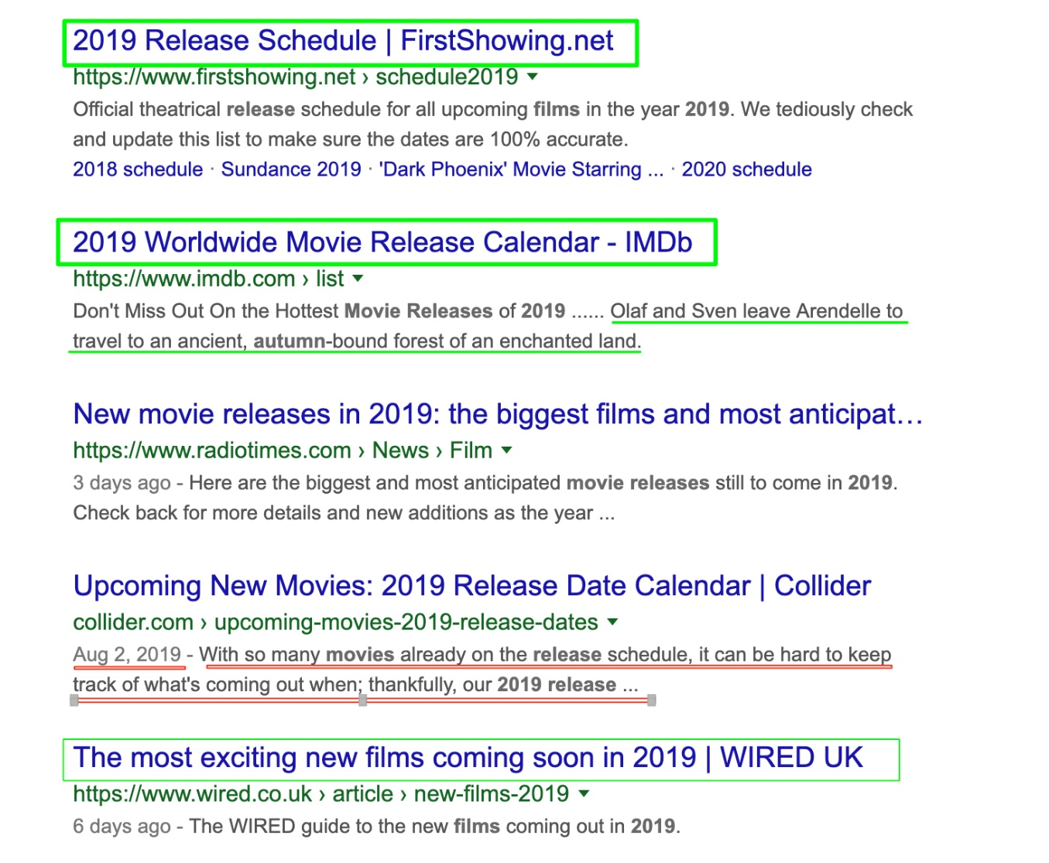
SERPS Page example
Page title with site name
Page title divided from site name with dash or pipe
Date page updated/reindexed
Short sentence for meta description otherwise page content used

Slide 7
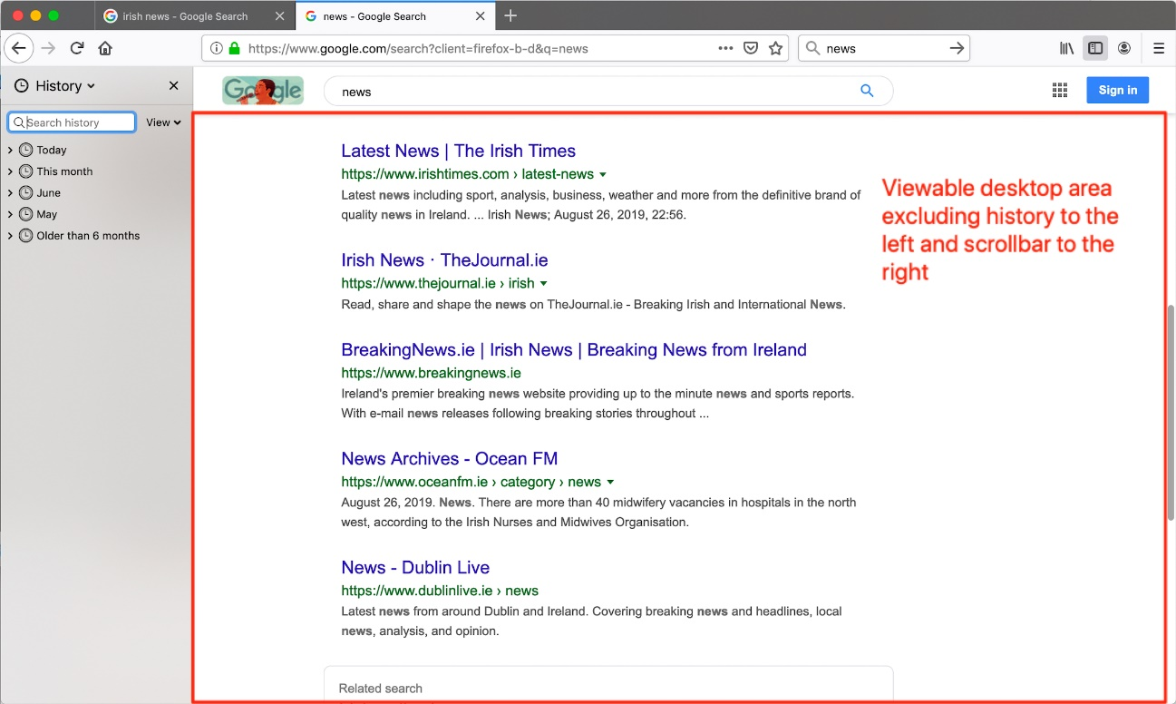
Viewport
The Viewport determines how a web page will appear on a mobile device
Even with Viewport set non-responsive sites will just be scaled to to fit the viewport (pinch & zoom)
Mobiles/tablets – viewport is size of glass

Slide 8
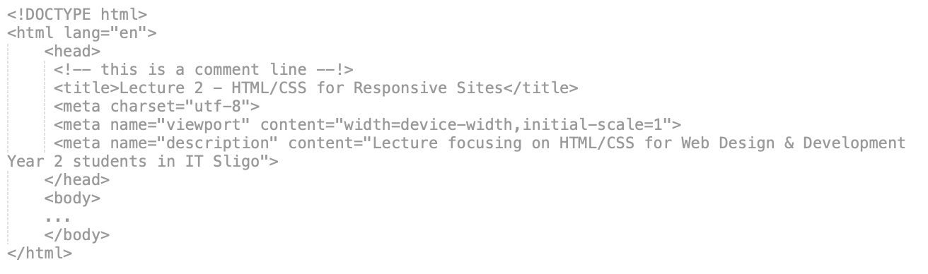
Viewport
Viewport is an attribute of the <meta> element
Width attribute – scales the page
Initial-scale attribute – scales the page when first loaded (the zoom factor)

Slide 9
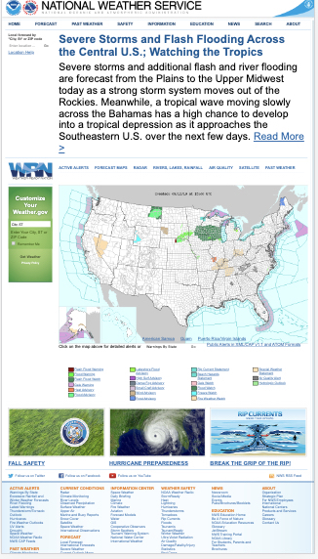
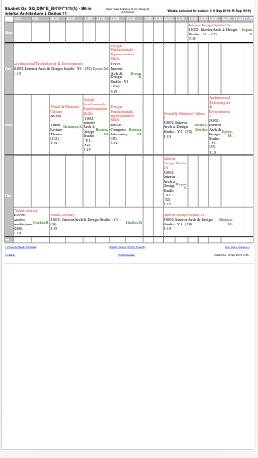
Pinch & zoom on mobile
According to Google..
“forcing the user to scroll horizontally or to zoom out in order to see the whole page results in a poor user experience.”

Slide 10
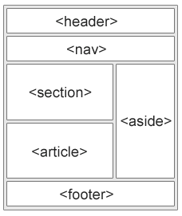
Structural elements
<body> elements contains all of the content for the page
New Semantics elements of HTML5
<body>
</body>

Slide 11
<header>
specifies a header for a web page or an article or a section
<header> can include the navigation area
If your <header> element only contains a single heading element - leave it out..

Slide 12
<nav>
<nav> indicates major navigation blocks on a page
Don’t apply to regular links, only to significant sections that are fully dedicated to navigation
does not need a heading - but useful for screen readers

Slide 13
<main>
<main> specifies the main content of a document
html4 versions by developers would have included :
<div id=“content”>, <div id=“main”>
Only used once per page
Any content that is repeated on multiple pages (eg. logo, search, footer) - is not placed within <main>

Slide 14
<article>
<article> specifies independent, self-contained content
Examples would include an article or news item on a newspaper, a blog post, forum post, blog comment
The article or content - should make sense when read in isolation
You can nest an <article> within another <article>

Slide 15
Example
<article>
<header>
<h1>Blog Post about html5</h1>
<p>Posted on 23rd September</p>
</header>
<p>blah blah</p>
<p>more blah</p>
</article>

Slide 16
<section>
<section> is a thematic grouping of content, typically with a header
Or <section> is a block of related elements
A sports <section> could have many <article> elements

Slide 17
Example
<h1>Sports</h1>
<p>All the sports news of the day.</p>
<section>
<h1>Football<h1>
<article>
<h1>Liverpool Win!</h1>
<p>blah blah</p>
</article>
<article>
<h1>Arsenal Lose</h1>
<p>blah blah</p>
</article>
</section>

Slide 18
<aside>
<aside> used for content that is related to the content around it - but is separate from the main content of the page.
Examples would include sidebar, monthly news archive, etc
Content that is neither article nor section nor navigation
Does not need a heading - but useful for screen readers

Slide 19
Articles and Sections
An article is a specialised kind of section. use it for self-contained, related content
You can have multiple articles within sections and multiple sections within article
Both can have a <header> and <footer>
Both can/should contain a heading
<article> is for syndication (stand alone)
<section> is designed for document structure and portability

Slide 20
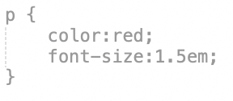


CSS
selector is p, element is <p>
rule
2 declarations
in this rule
property
value
CSS rules
Target generic elements (with .)
Target unique element (with #)
rendered
Introduction
A line of text
Another line of text

Slide 21
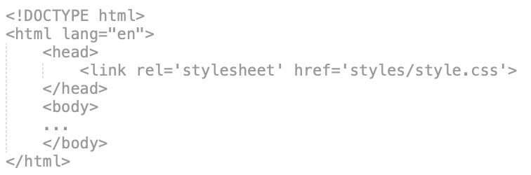
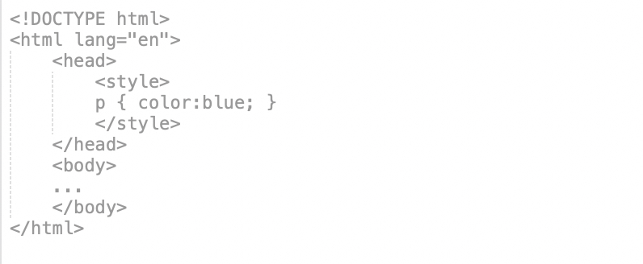
CSS
Linking (preferred)
Embedded
Including CSS
Inline

Slide 22
CSS
Default Values
If no styling browser defaults applied. Text element black, <a> is blue, underlined.
Inheritance
If an element does not have a style applied – it will inherit the style of its parent element
Reset
Section of CSS that initialises everything (reset stylesheet
First CSS rendered by the browser
Pre-built Reset
Eric Meyer’s Reset
Normalize.css (used in bootstrap)
<style>
p { color:blue; }
</style>
<p> Hello my name is <strong>Frank<strong></p>
Default Values, Inheritance, Reset

Slide 23
CSS
Specificity
Importance (!important)
Origin
Inheritance
The Cascade in CSS (determining what styles are applied to an element)

Slide 24
CSS
Inline styles
Internal style sheets (embedded)
External style sheets (imported or linked)
Browser defaults
Cascde
Cascading order of style sheets (origin)

Slide 25
CSS
Rules that are marked as important (with !important)
Inline style rules
Rules containing IDs
Rules containing classes, attributes, and pseudo-classes
Rules containing elements and pseudo-elements
Inherited rules
Default rules
Priority
Cascade
The cascade in cascading style sheets
The most specific rule wins – the ones with the most selectors –
the specificity
Understanding the Cascade (YouTube Video)
CSS Specificity : Things you should know (article)

Slide 26
CSS
p {
font-color:black!important;
}
Rules that are marked as important (with !important)
Inline style rules
Rules containing IDs
Rules containing classes, attributes, and pseudo-classes
Rules containing elements and pseudo-elements
Inherited rules
Default rules
<p style=‘color:red’>There was an error</p>
#row { background-color:grey; }
Cascade
Priority
warning.p { font-color:red; }
OR
a:hover { color:green; }
The cascade in cascading style sheets
p.Intro::first-letter { font-size:150%}
OR
H1:before { content:”~”;}
<p>sentence with <strong>bold</strong> text</p>
P {color:blue;}
What the browser uses as default if no styling

Slide 27
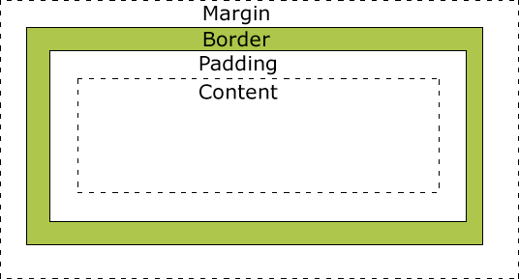
CSS
h1 {
padding:top right bottom left;
}
h1 {
padding:top right;
}
h1 {
width:300px;
padding:5px;
border:10px solid #333;
margin-top:15px;
}
h1 {
width:200px;
margin:15px 0 10px 5px;
padding:5px 10px;
border-bottom:5px solid #333;
}
Box model
The full size of the elements includes
padding, border AND margin

Slide 28
CSS
Block level element : always starts on a new line – includes p, div, h1, form, hr
Inline level element : does not start on new line, only takes up the space it needs – includes img, span, a, i, em, bold
display:inline; /* no width/height */
display:inline-block; /*we can set width/height/paddings/margins */
Block and inline

Slide 29
Browsers
Market Share
Browser Market Share (desktop)
Browser Market Share (mobile)
Browser Market Share (tablet)
Browser engine is rendering + javascript support
Chrome, Edge, Brave, Opera (Chromium using Blink engine)
Firefox (Gecko engine)
Safari (WebKit engine)
So long Internet Explorer…
Many browsers means more testing (e.g. browserstack.com)

Slide 30
Prefixes
.roundcorners {
-webkit-border-radius: 12px;
-moz-border-radius: 12px;
border-radius: 12px;
}
Safari
Firefox
Everything else

Slide 31
Writing CSS
CSS Prefixes
How to know which CSS3 properties need prefixes
caniuse.com
Should I prefix
Style Guide - general Principles, whitespace, comment,formatting
https://github.com/necolas/idiomatic-css

Slide 32
Links used in these slides
SERPS
https://www.marketingterms.com/dictionary/serp/
Viewport
https://thecontentworks.uk/size-content-viewport/
Browser Reset
https://meyerweb.com/eric/tools/css/reset/
Normalize.css
Understanding the cascade
https://www.youtube.com/watch?v=NP8USarU6X0
CSS Specificity – things you should know
https://www.smashingmagazine.com/2007/07/css-specificity-things-you-should-know/
CSS Prefixes
How to know which CSS3 properties need prefixes
caniuse.com
Should I prefix
CSS Style Guide
https://github.com/necolas/idiomatic-css

